Slide 1
Species and trophic dynamics
October 22, 2019

Slide 2
Why do we care about anything other than plants and microbes?
Dominate energy (>95%) and nutrient transfer in terrestrial ecosystems
NPP uncertainty is greater than energy transfer from plants to animals

Slide 3
What is the purpose of a food web?

Slide 4
Who controls these interactions?

Slide 5
Bottom up controls

Slide 6
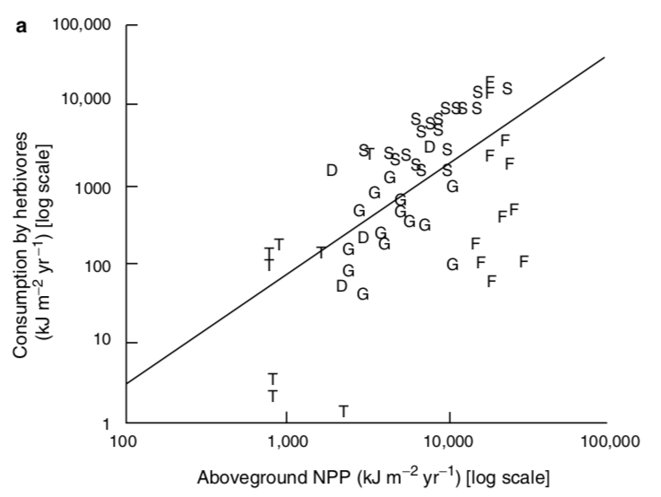
Herbivory increases with NPP

Slide 7
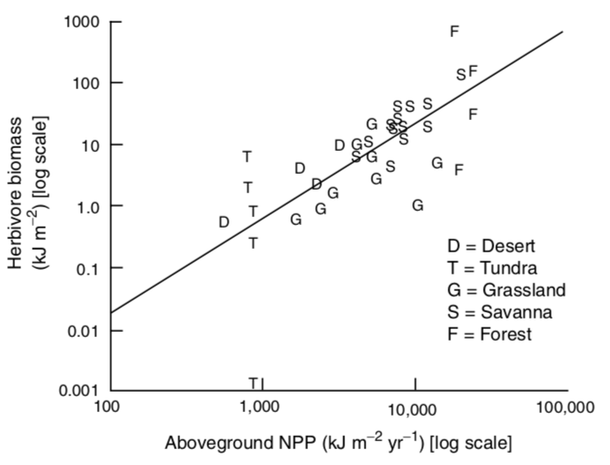
Herbivore biomass increases with NPP

Slide 8
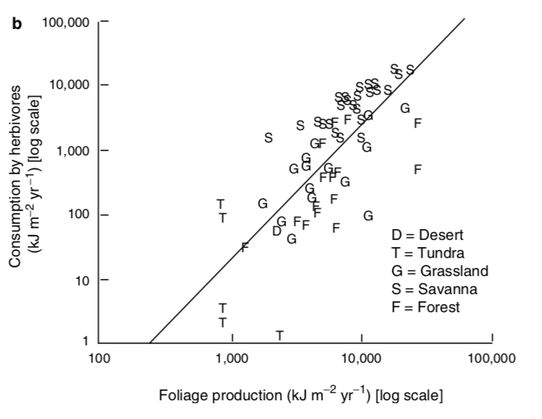
Actually driven by leaf production
Why?

Slide 9
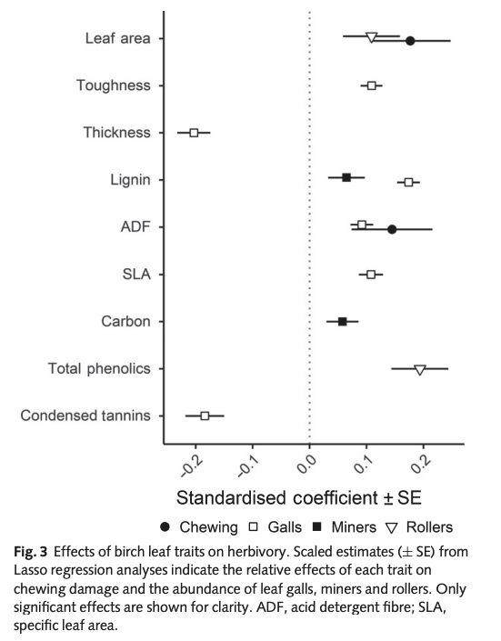
Leaf traits influence herbivory
Muiruri et al. (2019) New Phytologist

Slide 10
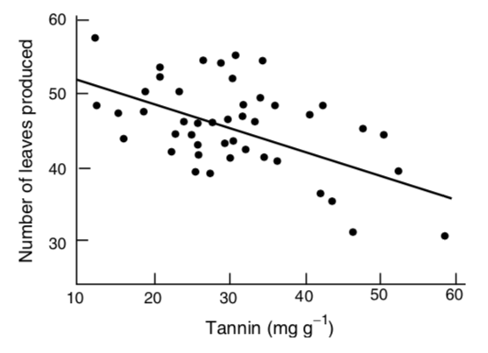
But there is a trade-off

Slide 11
But there is a trade-off
So maybe plants aren’t fully driving these interactions!

Slide 12
Top down controls

Slide 13
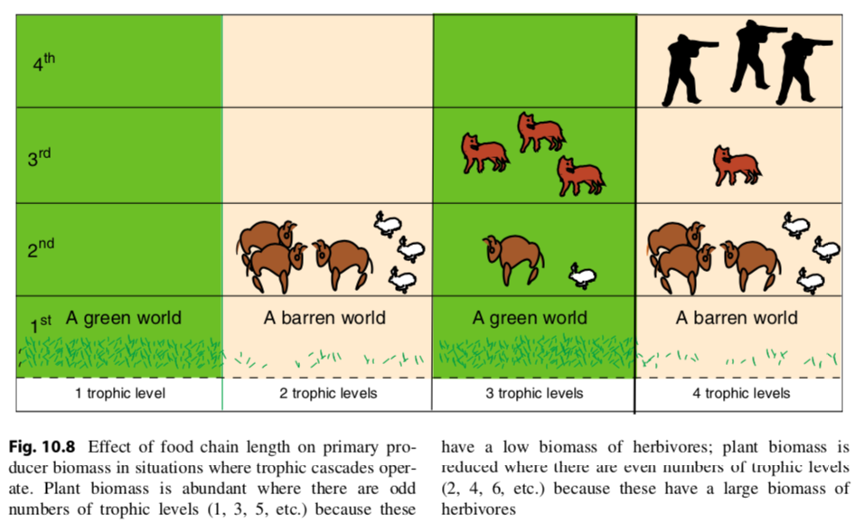

Slide 14
What types of organisms exert the strongest top-down controls?

Slide 15
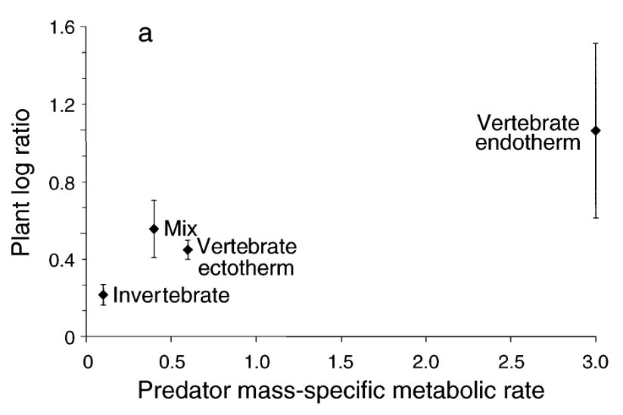
Top-down control strength
Borer et al. (2005)

Slide 16
Energy flow through trophic levels

Slide 17
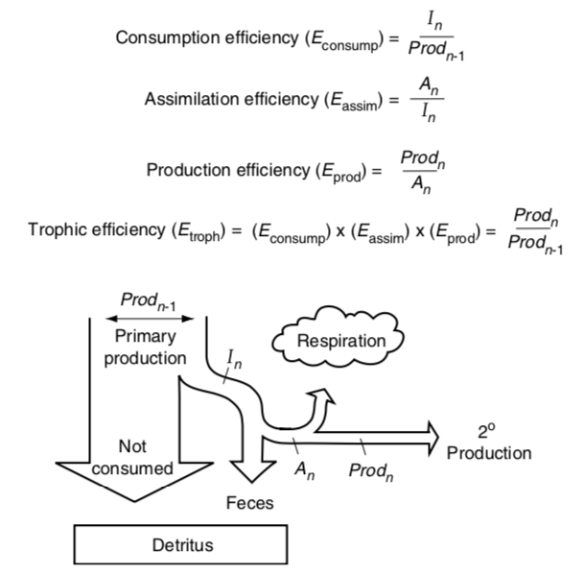

Slide 19
Percent on production by lower trophic level that is consumed by the higher trophic level

Slide 20
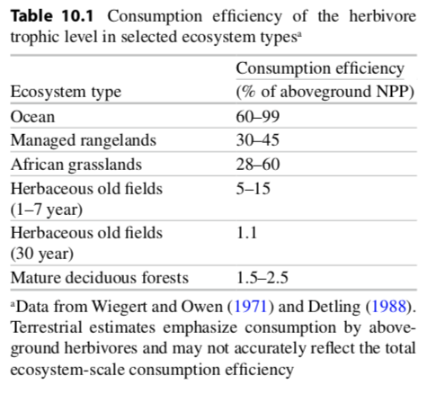

Slide 21
The amount consumed that is assimilated into the organism (not pooped out)

Slide 22
Carnivores have 4x greater assimilation efficiencies than herbivores. Why?

Slide 23
The amount assimilated that is not respired

Slide 24
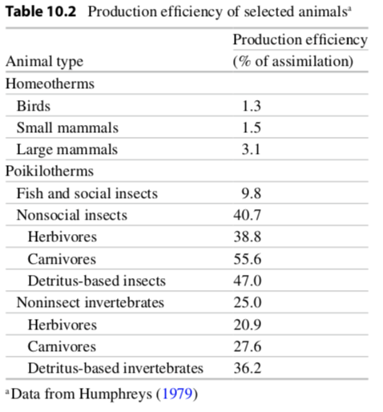

Slide 25
Efficiency of the trophic level

Slide 26
Activity: what is the largest food chain you can create?
Notes:
To determine what controls food chain length

Slide 27
How does nutrient and energy flow differ?

Slide 28
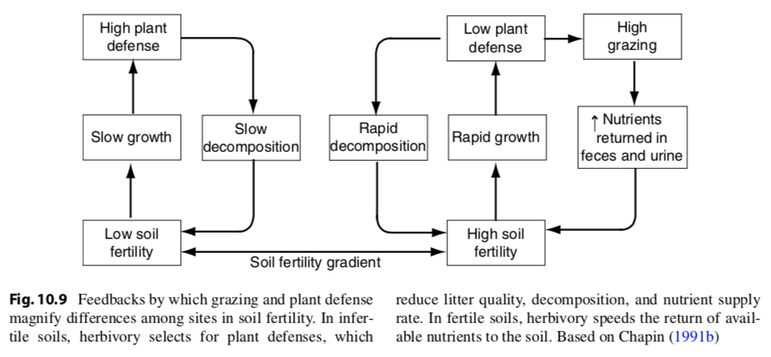
Herbivores speed nutrient flow

Slide 29
Species-level impacts

Slide 30
Some species have larger impacts on ecosystem processes than others. Agree/disagree? Why?

Slide 31
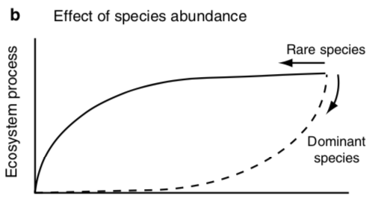
Dominant species drive ecosystem processes
Species Richness

Slide 32
Effect might be dependent on time
Process difference from control
Years since dominant species removal
Read et al. (2017)

Slide 33
Effect might be dependent on time
Community is filling the niche of the dominant species
Process difference from control
Years since dominant species removal
Read et al. (2017)

Slide 34
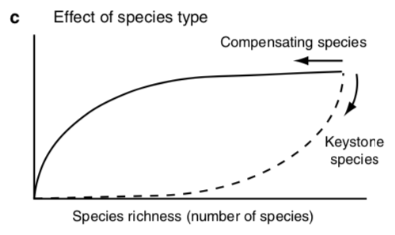
Keystone species drive ecosystem processes
Ecosystem process

Slide 35
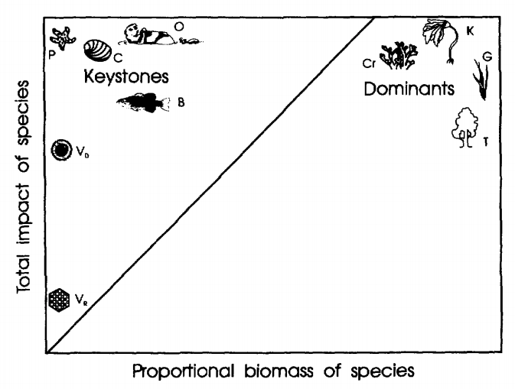
Keystones have importance that outweighs abundance
Power et al. (1996)

Slide 36
Functional types describe the life history strategy of a species
Broadleaf tree
Needleleaf tree
Deciduous tree
Shrub
Grass

Slide 37
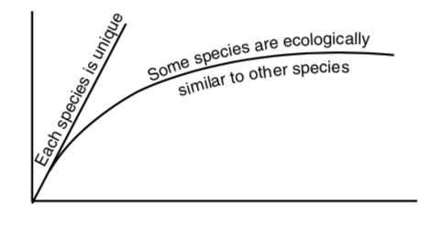
And this can influence ecosystem processes…
Ecosystem Process
Number of species

Slide 38
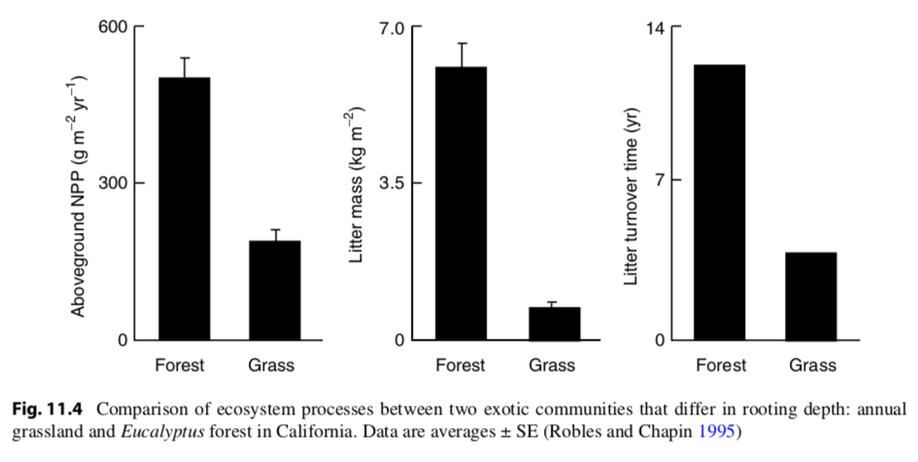
…such as biomass…

Slide 39
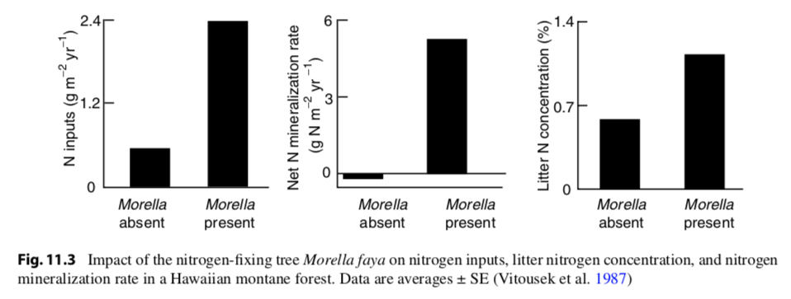
…nutrient supply…

Slide 40
…nutrient turnover…

Slide 41
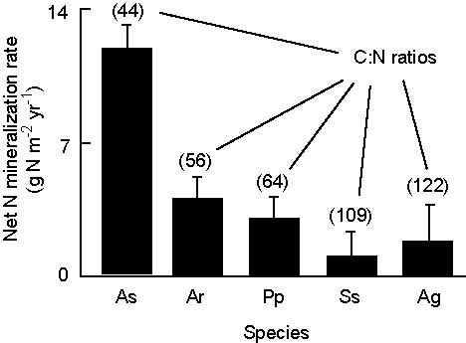
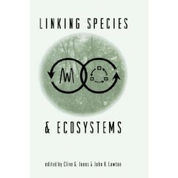
…nutrient turnover…
(Jones & Lawton 1995)

Slide 42
…nutrient turnover…
(Jones & Lawton 1995)

Slide 43
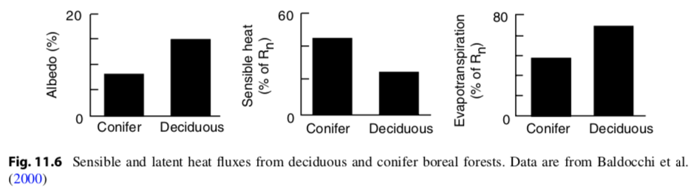
…biophysics…

Slide 44
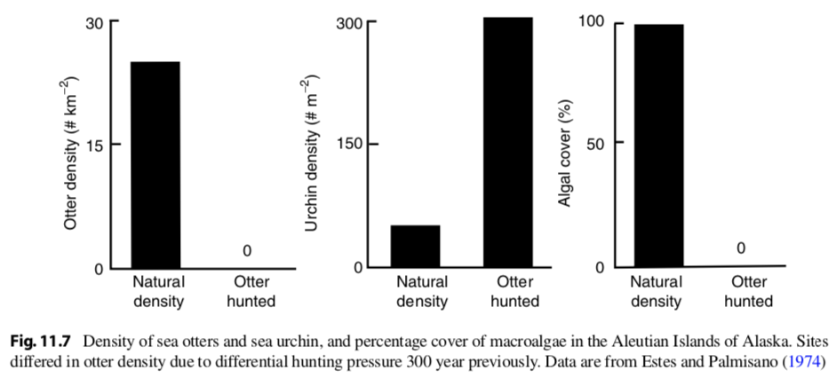
…trophic dynamics…

Slide 45
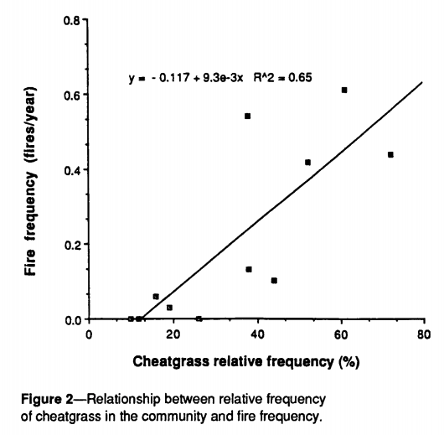
…and disturbance regimes
Bromus tectorum (cheatgrass)
Sagebrush steppe
Whisenant (1989)

Slide 46
Biodiversity – some definitions
Richness: total number of species in a given area
Evenness: relative abundance of the species present
Species diversity: a combination of richness and evenness
Larger if more species
Larger if species are evenly distributed

Slide 47
 | Community A | Community B
Species 1 | 5 | 10
Species 2 | 60 | 10
Species 3 | 0 | 10
Which community has higher richness?
Which community has higher evenness?
Which community has greater diversity?

Slide 48
 | Community A | Community B
Species 1 | 5 | 10
Species 2 | 5 | 10
Species 3 | 0 | 10
Which community has higher richness?
Which community has higher evenness?
Which community has greater diversity?

Slide 49
How does diversity influence ecosystem services?

Slide 50
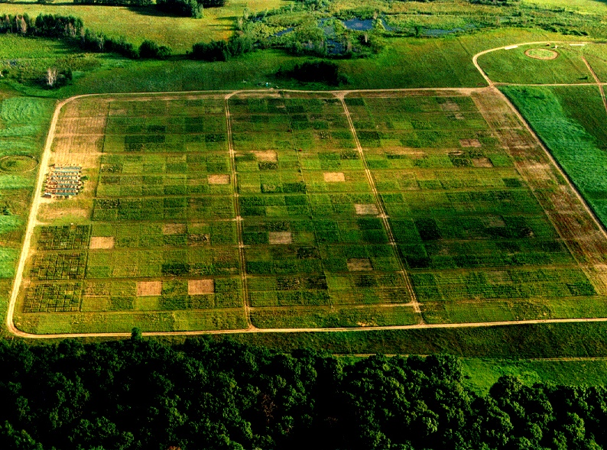

Slide 51
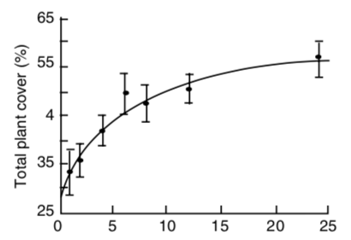
Species richness
Tilman et al. (1996)

Slide 52
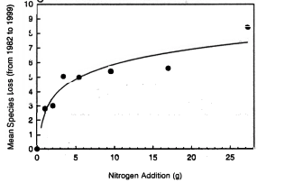
Threats to biodiversity: Eutrophication
Competition can increase biodiversity
Eutrophication is the increase of nutrients to natural ecosystems
Reduces competition
Enhances the dominance of a few species
N addition causes species loss in Minnesota (Tilmann et al. (1994))

Slide 53
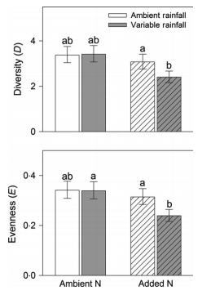
Threats to biodiversity: Eutrophication
Smith et al. (2016)

Slide 54
Threats to biodiversity: Invasive species
Sometimes the competitors are too good, and biodiversity decreases
Invasive species possess traits that native species do not have
Enhanced tolerance
Fast reproduction
No predators
No competitors
Diversity decreases invasion, invasion decreases diversity
Kudzu in SW US

